Slide 1

Azure DevTest Labs - What the heck is it?
Stefan Johner
https://blog.jhnr.ch
@JohnerStefan

Slide 2
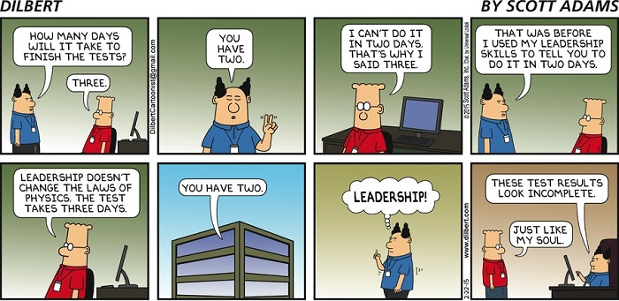

Slide 3
Your DevTest investments are significant
50%
of infrastructure spent on non-production

Slide 4
Traditional infrastructure deployment
Unused capacity
Auto-scaled, on-demand Azure capacity
Demand
Time
Notes:
When Devs are working you see peaks, at night or weekends infrastructure is not used
When using DevTest environments with traditional infrastructure the will be a lot of unused capacity because you need to cover even the biggest spikes
When using Azure you can map your infrastructure spending closely to your needs. You only pay for what you use with per minute billing

Slide 5
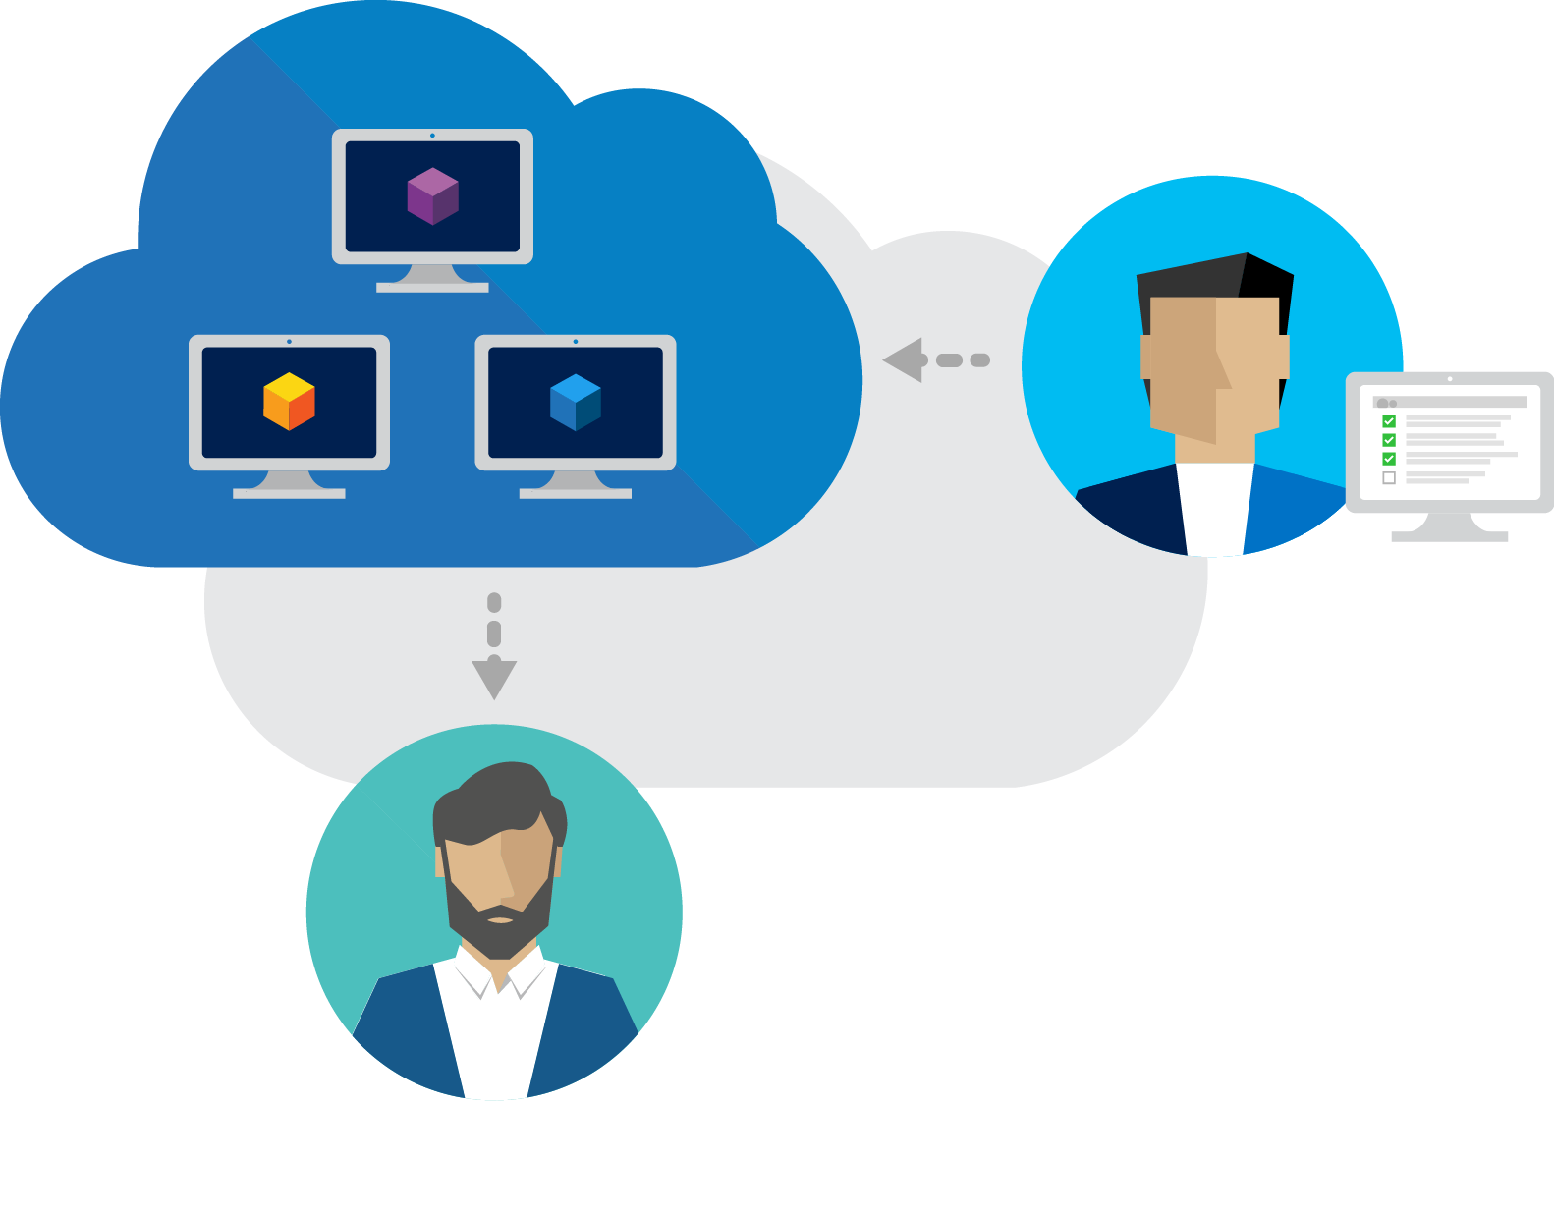
Azure DevTest Labs
Solution for fast, easy, and agile dev-test environments in Azure.
Fast provisioning
Automation & self-service
Cost control and governance
Notes:
Azure DevTest Labs is an Azure service that enables you to quickly create environments in Microsoft Azure while minimizing waste and controlling cost.
Fast provisioning of Azure “labs”
Control WHAT is provisioned
Control HOW it is provisioned
Control HOW MUCH budget
Control WHEN to use it
DevTest Labs aka Sandboxes

Slide 6



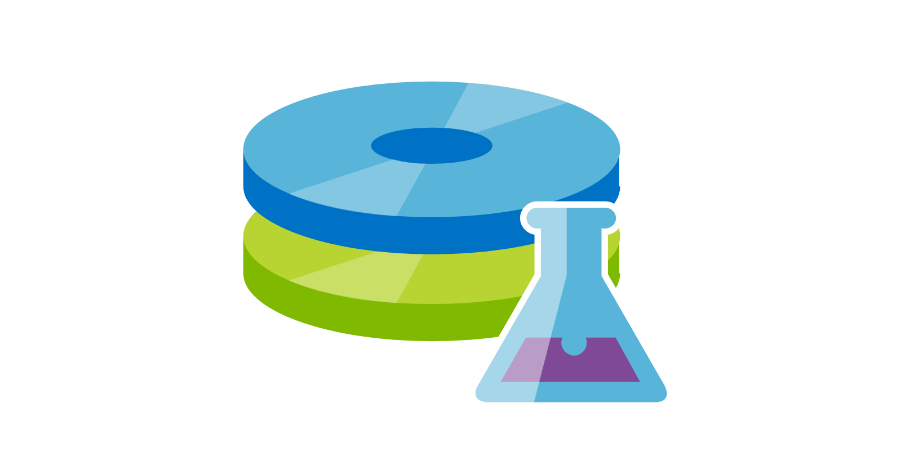
Developer Machines
Intranet
Notes:
Developers can quickly provision their development machines on demand.
Developers can easily customize their development machines whenever needed.
Administrators can control costs by ensuring that:
Developers cannot get more VMs than they need for development.
VMs are shut down when not in use.

Slide 7
Test environments
✓
Check-in
Build
Test
Release
Notes:
Testers can test the latest version of their application by quickly provisioning Windows and Linux environments using reusable templates and artifacts. Testers can scale up their load testing by provisioning multiple test agents. Administrators can control costs by ensuring that: Testers cannot get more VMs than they need.
VMs are shut down when not in use.

Slide 8

Training / Education
Notes:
Azure DevTest Labs allows you to create a lab where you can provide custom templates that each trainee can use to create identical and isolated environments for training. You can apply policies to ensure that training environments are available to each trainee only when they need them and contain enough resources - such as virtual machines - required for the training. Finally, you can easily share the lab with trainees, which they can access in one click.

Slide 9
Trial / Demo

Slide 10
Behind The Scenes

Slide 11
Control your lab
Access
Images
VM Sizes
Number of VMs
Auto-Start/Shutdown
Virtual Networks
Notes:
Lab owner - A lab owner has the access to any resources within the lab. Therefore, they can modify policies, read and write any VMs, change the virtual network, and so on.
Contributor – Same as Owner, but cannot add User permission to lab
Lab user - Create VMs, Modify his own VMs, Apply Artifacts, Add/Update/Delete Formulas
Policies help in controlling cost in your lab. For example, you can create a policy to automatically shut down VMs based on a defined schedule.
Caps is a mechanism to minimize waste in your lab. For example, you can set a cap to restrict the number of VMs that can be created per user, or in a lab.

Slide 12
Demo How to control your lab

Slide 13

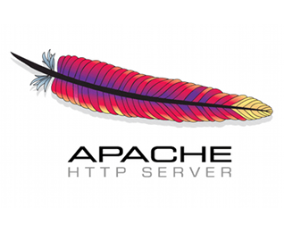

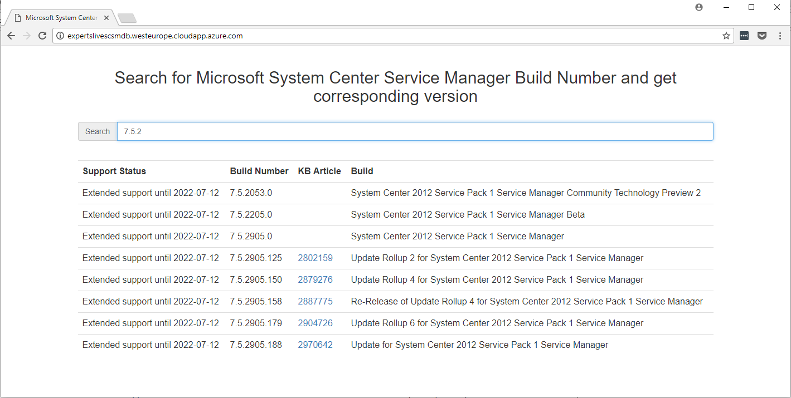









Problem
This Photo by Unknown Author is licensed under CC BY-SA
This Photo by Unknown Author is licensed under CC BY-SA
Notes:
Big puzzle to solve every time you want to deploy this app for testing or development

Slide 14
How to provision?
Marketplace provides Base Images
Custom Images (create or upload)
Add tools & software customizations via Artifacts
Predefine dynamic images using Formulas
Multi-Service environments using ARM templates
Integrate into CI/CD tools like Visual Studio Team Services
Notes:
Mindset destroy and recreate

Slide 15
Custom Images
Bright side:
VM provisioning from a custom image is fast
VMs created from a single custom image are identical.
Down side
If you need to update some aspect of the custom image, the image must be recreated.
Notes:
VM provisioning from a custom image is fast as nothing changes after the VM is spun up from the image. In other words, there are no settings to apply as the custom image is just an image without settings.
Base images are VM images with all the tools and settings preinstalled and configured to quickly create a VM. You can provision a VM by picking an existing base and adding an artifact to install your test agent. You can then save the provisioned VM as a base so that the base can be used without having to reinstall the test agent for each provisioning of the VM.

Slide 16




Artifacts
Default Repo
Other Repos
Notes:
Artifacts are used to deploy and configure your application after a VM is provisioned. Artifacts can be: Tools that you want to install on the VM - such as agents, Fiddler, and Visual Studio. Actions that you want to run on the VM - such as cloning a repo. Applications that you want to test.
Artifact repositories are git repositories where artifacts are checked in. Artifact repositories can be added to multiple labs in your organization enabling reuse and sharing.
Artifacts are Azure Resource Manager JSON files that contain instructions to perform deployment and apply configuration.

Slide 17
Formulas
Bright side:
Changes in the environment can be captured on the fly via artifacts.
Formulas can define default settings - such as VM sizes and virtual network settings.
The settings saved in a formula are shown as default values, but can be modified when the VM is created.
Down side
Creating a VM from a formula takes more time than creating a VM from a custom image.
Notes:
Formulas, in addition to base images, provide a mechanism for fast VM provisioning. A formula in DevTest Labs is a list of default property values used to create a lab VM. With formulas, VMs with the same set of properties - such as base image, VM size, virtual network, and artifacts - can be created without needing to specify those properties each time. When creating a VM from a formula, the default values can be used as-is or modified.
For example, if you want a VM installed with the latest bits from your release pipeline or enlist the latest code from your repository, you can simply specify an artifact that deploys the latest bits or enlists the latest code in the formula together with a target base image. Whenever this formula is used to create VMs, the latest bits/code are deployed/enlisted to the VM.

Slide 18
Environments
Use ARM templates to deploy solutions
Deploy multiple resources repeatedly
Can contain PaaS resources
Appear in cost tracking
No Auto-Shutdown for PaaS
Notes:
You can use Azure Resource Manager templates to define the infrastructure and configuration of your Azure solution and repeatedly deploy multiple test VMs in a consistent state.
Azure PaaS resources can be provisioned in an environment from a Resource Manager template and appear in cost tracking. However, VM auto shutdown does not apply to PaaS resources.

Slide 19
CI/CD Pipeline Integration
DevTest Labs Tasks are build/release tasks for VSTS which allow you to integrate with Azure DevTest Labs
Create VM
Create Custom Image
Delete VM
VSTS has 240min/month of FREE cloud-hosted build agent time with Windows, Linux and now Mac images, all available for cloud-powered build!
Notes:
The task allows you to create a Custom Image in your lab based on an existing lab VM. You can install your latest build on a Lab VM and then create a custom image based on the VM. You can quickly create a lab VM using the custom image with the latest build already baked in. Moreover, the custom image is shared with all the users in the lab. Any lab user can use the custom image to create a lab VM and get started with the testing of the latest build in minutes.
The task allows you to create a lab VM using an ARM template generated in your Lab. You can generate the ARM template by selecting all the configurations required to create a lab VM and also adding artifacts which you want to apply after the VM is created.

Slide 20

Power of Combo
Auto-deploy VMs for Testers when releasing new build
Use Artifacts and Custom Images together with VSTS

Slide 21
Demo How to provision

Slide 22
Why DevTest Labs
Quickly be «ready to test»
Azure DevTest Labs service is free
Don’t worry about VNets, Resource Groups, etc.
Control dev/test environments with ease
Integrates with your existing toolchain

Slide 23
How to get started
Azure DevTest Labs http://aka.ms/adt
DevTest Labs Team Blog https://blogs.msdn.microsoft.com/devtestlab/
DevTest Labs Documentation https://docs.microsoft.com/en-us/azure/devtest-lab/devtest-lab-overview
DevTest Labs MSDN Forum https://social.msdn.microsoft.com/Forums/en-US/home?forum=AzureDevTestLabs
Azure DevTest Labs artifacts, scripts and samples https://github.com/Azure/azure-devtestlab

